Slide 1
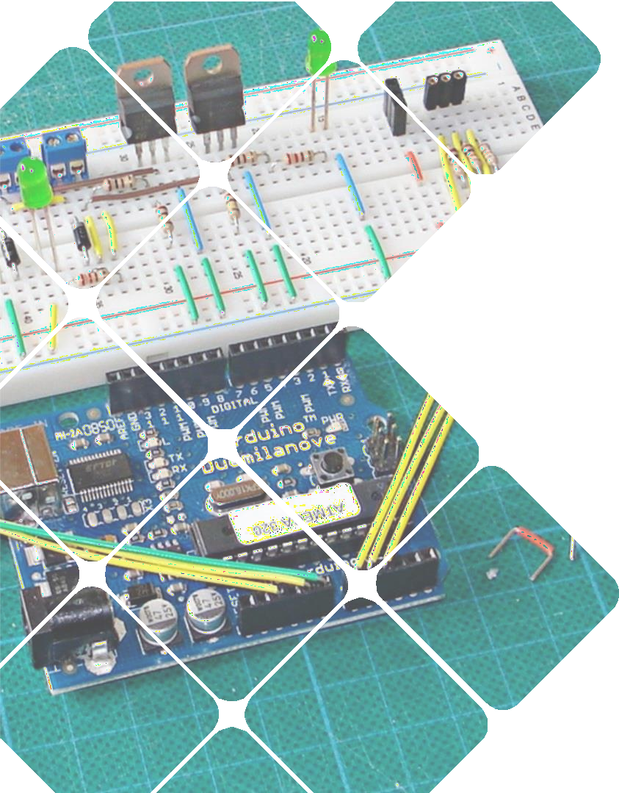


MTE 3104: : MICROCONTROLLER AND INTERFACING SESSIONAL
A TRAFFIC CONTROL AUTOMATION SYSTEM
Presented by:
Md. Abu Sian (2008031)
Md. Ahsan Habib(2008032)
Anik Das (2008033)
Krisna Chandra paul(2008034)
Md. Ohidul Islam(2008035)
Submitted to Md. Sakib Hassan Chowdhury Lecturer Department of Mechatronics Engineering Rajshahi University of Engineering & Technology, Rajshahi-6204.

Slide 2
INTRODUCTION
Objectives
To automate traffic management using microcontrollers.
To ensure efficient traffic flow and enhanced safety.
To ensure cost effective way for traffic management.
Key Features
Round Robin Traffic Control: Automatically manages traffic flow using time intervals.
Emergency Vehicle Detection: Detects emergency vehicles and prioritizes them immediately.
Train Detection: Pauses road signals when a train is detected.
A TRAFFIC CONTROL AUTOMATION SYSTEM

Slide 3
SYSTEM OVERVIEW
COST TABLE
List of components | Quantity | Price
Arduino uno | 2 | 1800
Traffic signal LED lights with wire | 4 | 500
RFID RC522 | 1 | 300
Servomotor | 2 | 400
IR sensor | 2 | 240
RFID tag | 4 | 200
Jumper wire | 100 | 200
Bread board | 1 | 150
PVC board | 3’×3’ | 240
 | Total | 4030
A TRAFFIC CONTROL AUTOMATION SYSTEM

Slide 4
WORKING PROCESS
Round Robin Traffic Control: The system uses micros() to manage time delays, giving each road a 5-second green signal before switching traffic.
Train Detection: Two IR sensors detect trains, halting road signals to red. After the train passes, normal traffic control resumes.
Emergency Vehicle Detection: The master-slave system uses RFID to detect emergency vehicles, granting green signals and resuming normal traffic control afterward.
Start
Check Time delay
Repeat
Switch signal
Check IR sensors
Check RFID
Update signals
Fig. 2: Working process flowchart.
A TRAFFIC CONTROL AUTOMATION SYSTEM

Slide 5
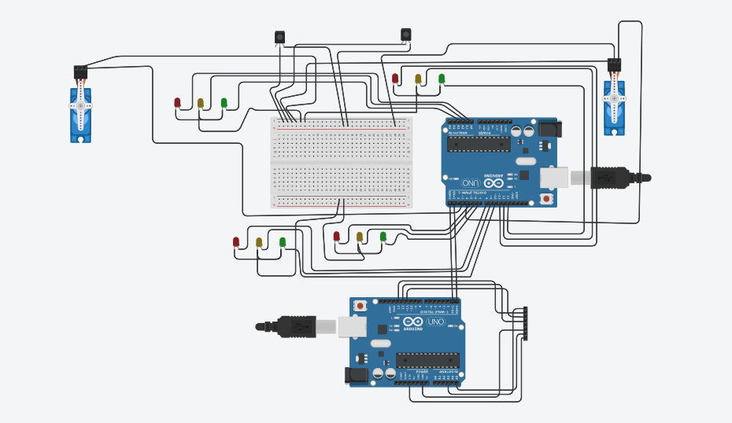
CIRCUIT DIAGRAM
A TRAFFIC CONTROL AUTOMATION SYSTEM

Slide 6
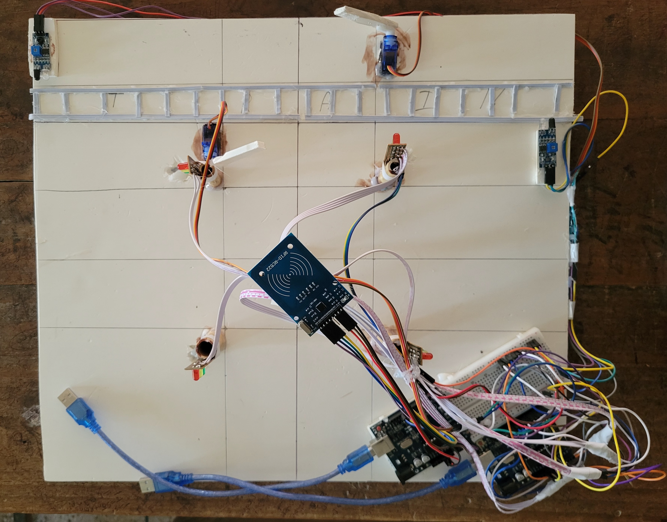
PROJECT OUTLOOK
A TRAFFIC CONTROL AUTOMATION SYSTEM

Slide 7
PLANNED FUTURE FEATURES
Vehicle density detection
Data logging and analysis using computer vision
Pedestrian walking integration
Renewable energy sources to power the system
A TRAFFIC CONTROL AUTOMATION SYSTEM

Slide 8
Thank you
A TRAFFIC CONTROL AUTOMATION SYSTEM

